Slide 1
Workshop 4 - Computer Vision and Machine Learning

Slide 2
Workshop 4 Objectives
By the end of this workshop, students can control drones with python code by:
• Using loops and array
• Using video stream from drone camera
• Using OpenCV libraries to detect color and circles from video stream
• Using machine learning to detect object

Slide 3
Loops and Array in Python
(20 minutes lecture and 60 minutes hands-on breakout activities)

Slide 4

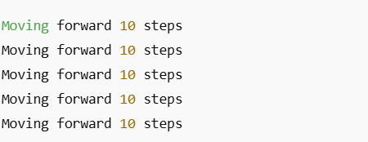
Comparing Loops in Block Coding and Python
Example in Scratch:
"Repeat 5 times → Move forward 10 steps"
Python for loop is equivalent to Repeat:
Output:

Slide 5
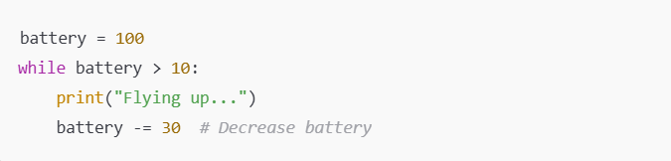
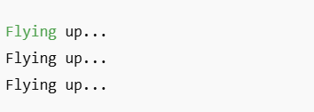
Comparing Loops in Block Coding and Python
Example in MakeCode:
"While battery > 10 → Fly up"
Python while loop equivalent:
Output:

Slide 6
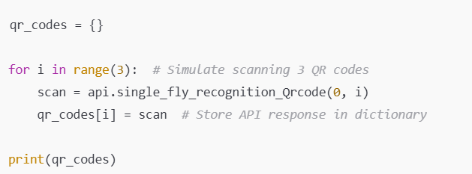
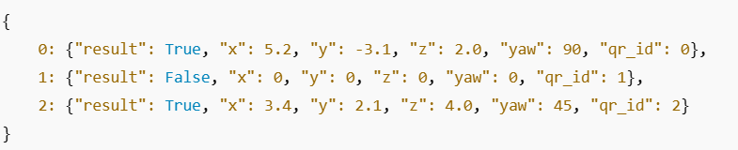
Scanning QR code multiple times with loop
When scan once, the drone might not detect it. Let’s loop to scan a few times to increase success:
Example output:

Slide 7
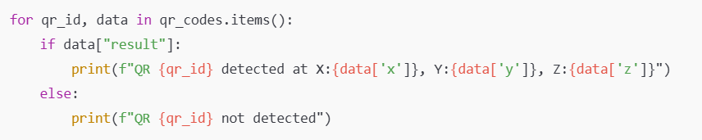
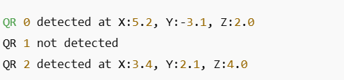
Using For loop to loop through QR results
Use a for loop to process stored QR code results:
Example output:

Slide 8


Python Array (List)
Python lists (arrays) store multiple items in a single variable like list block in Scratch or Makecode.
Declaring an Array (list):
Example output:

Slide 9


Accessing Array Elements
Accessing specific item in Array:
Using the index of item which starts from 0.
Output:

Slide 10
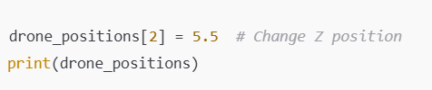

Modifying Array Elements
Change values in the array:
Using the index of item which starts from 0.
Output:

Slide 11

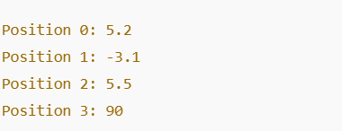
Accessing items in array using loop
Loop using index values:
Output:

Slide 12
Hands-on Breakout Activities (60 minutes)
Do all questions in Section 2 of Workshop 4 Quiz.

Slide 13
Using Video from the drone and Detecting ball
(15 minutes lecture and 105 minutes hands-on breakout activities)

Slide 14
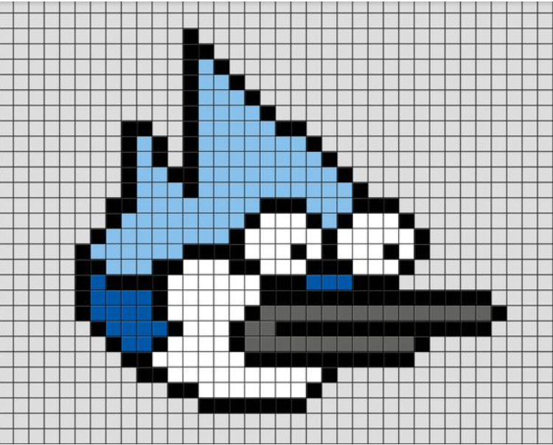
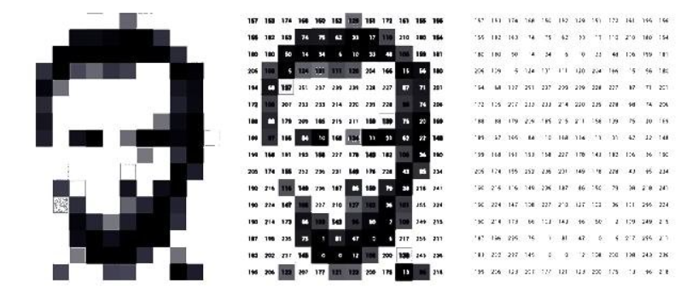
How Computers See, Capture and Store Images
A digital camera captures an image as a collection of pixels. The camera capture video by capturing image by image.
Each pixel represents a small portion of the image and holds color information.
Images are stored as a two dimensional numerical array (like x-y graph) where each pixel has values corresponding to its color.
The resolution of an image (e.g., 1920x1080) determines the number of pixels.
Color images typically store three values per pixel (Red, Green, Blue) in the RGB model or HSV model.

Slide 15
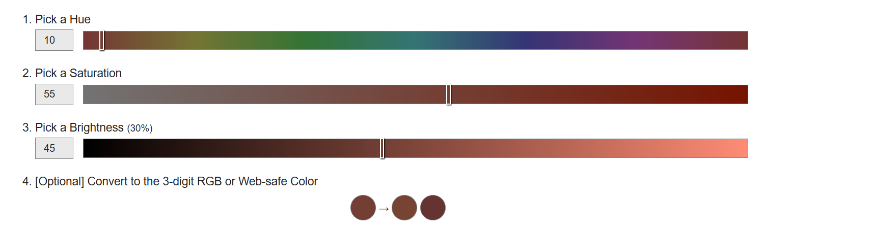
RGB vs. HSV Color Models
RGB (Red, Green, Blue): Standard model for digital images.
Each pixel has values for R, G, and B (0-255 each).
HSV (Hue, Saturation, Value): Alternative color model useful for detecting colors.
Hue: Color type (0-360 degrees)
Saturation: Intensity of the color (0-100%)
Value: Brightness of the color (0-100%)
How to find out HSV value for a color:
Online tool: https://www.selecolor.com/en/hsv-color-picker/
Or use photo editor like GIMP or photoshop.

Slide 16
Let’s use OpenCV. What is OpenCV?
We do not need to write code to process pixel by pixel. We use OpenCV library.
OpenCV (Open Source Computer Vision Library) is an open-source library for computer vision tasks.
Used for showing image and video, image processing, object detection, facial recognition, and more.
Supports Python, C++, and Java.

Slide 17
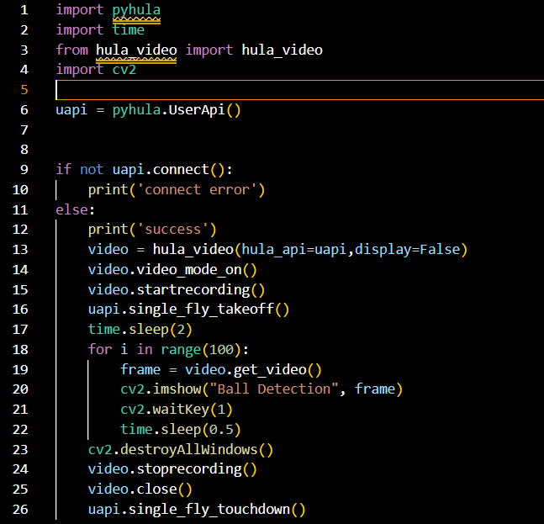
Use hula_video library to get video from drone
Line 13: Initializes video streaming (hula_video) without displaying the video (display=False).
Line 14: Starts video mode by asking the drone to stream video
Line 15: Use hula_video to store video in files. It stores one frame one file. Tell it to begin recording.
Line 19: Loops 100 times to capture video frames from the drone's camera because the drone captures the video image by image one by one. frame contains one image which is an array.
Line 20: Displays one video frame in a window titled "Ball Detection". cv2.imshow() very important
Line 21: cv2.waitKey(1) ensures the video updates continuously.
How to use?
Download hula_video.py from Workshop 4 assignment Google Classroom and put in folder where your code is.
Check out hula_video_api.txt to find out the other functions in hula_video.
This code on the right is in Workshop 4 assignment. The file is sample-use-hula-video.py.

Slide 18
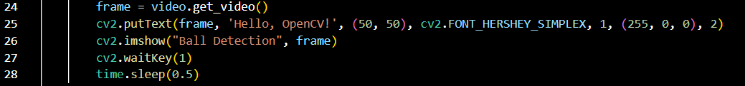
Writing Text on an Image in OpenCV
Python Code (add on to previous slide code) to put text on frame before showing:
Explanation:
cv2.putText() adds text to an image.
Parameters:
Image to modify (frame).
Text to display ('Hello, OpenCV!').
Coordinates of the text (50, 50).
Font type (cv2.FONT_HERSHEY_SIMPLEX).
Font scale (1).
Color ((255, 0, 0), which is blue in BGR format).
Thickness of text (2).

Slide 19
Writing an Image to a file in OpenCV
Python Code (add on to previous slide code) to put text on frame before showing:
Explanation:
cv2.imwrite() write a frame to a file according to the filename given. text to an image.
Parameters:
Image to modify (frame).
filename (filename).

Slide 20
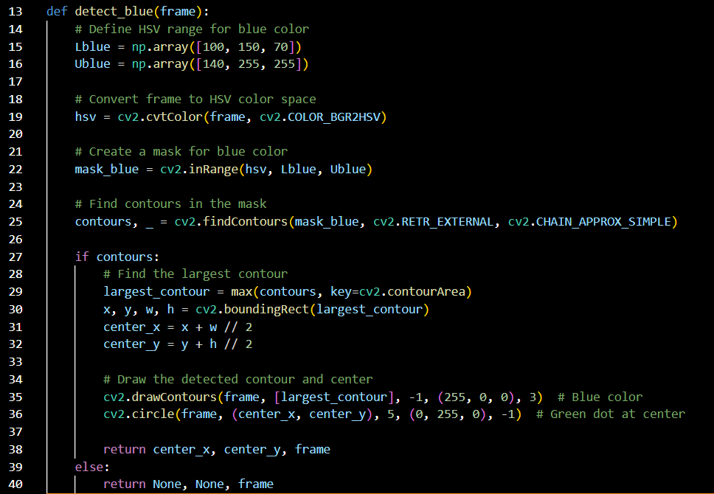
Use OpenCV to detect blue ball from a video frame
How Does It Work?
Line 15 and 16: Define the Blue Color Range
Colors in images are represented using different models, and one popular model is HSV (Hue, Saturation, Value).
The function defines a range of blue colors in HSV format. This helps the computer understand what “blue” looks like.
Line 19: Convert the Image to HSV Format
The function changes the image from the standard BGR (Blue-Green-Red) format to HSV because HSV makes it easier to detect specific colors.
Line 22: Create a Mask for the Blue Color
A mask is like a filter that keeps only the blue parts of the image and ignores everything else.
Line 25: Find the Blue Object in the Image
The function searches for shapes (contours) in the filtered image where blue color is detected.
Line 29: Identify the Largest Blue Object
If the function finds multiple blue objects, it picks the biggest one. This helps ensure that we’re detecting the correct object (e.g., the biggest blue ball in view).
Line 35 and 36: Mark the Ball in the Image
It draws an outline around the detected ball using a blue line.
It also places a small green dot in the center of the ball to indicate its position.
Return the Ball’s Position
Line 38: If a blue ball is found, the function returns the X and Y coordinates of its center.
Line 40: If no ball is found, it returns None.
THIS CODE IS IN detect_blue_ball_function_only.py

Slide 21
Hands-on Breakout Activities (105 minutes)
Do all questions in Section 3 of Workshop 4 Quiz.

Slide 22
Introduction to Machine Learning & Computer Vision
(15 minutes lecture and 105 minutes hands-on breakout activities)

Slide 23
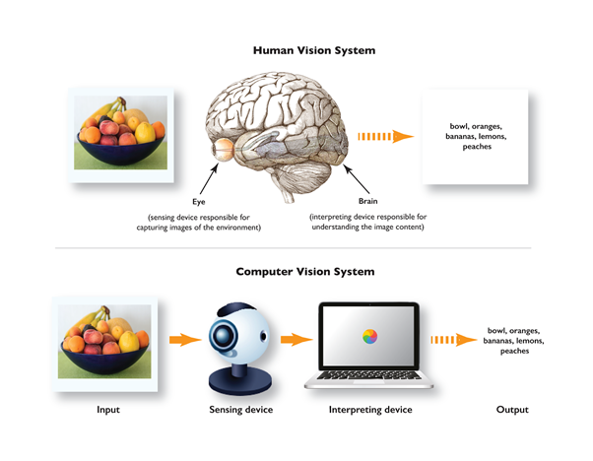
Introduction to Machine Learning & Computer Vision
Machine learning allows computers to recognize patterns in images.
How does machine learning work?
Machine learning models are trained on large datasets to identify patterns and features.
In supervised learning, a model is given labeled images (e.g., pictures of cats and dogs) and learns to classify them.
Convolutional Neural Networks (CNNs) are specialized models used for image recognition.
The model extracts important features (edges, colors, textures) and adjusts weights through multiple iterations to improve accuracy.
Once trained, the model can make predictions on new, unseen images.
Deep learning techniques, like CNNs, are used for image classification and object detection.
TensorFlow and TensorFlow Lite (TFLite) are popular tools for creating machine learning models for computer vision tasks.

Slide 24
Comparing OpenCV Detection vs. Machine Learning
OpenCV Detection (For example - Ball detection)
Uses color filtering and contour detection.
Works well for simple shapes and colors.
Sensitive to lighting conditions and color variations.
Speed: Faster since it relies on simple image processing techniques.
Machine Learning-Based Object Detection:
Uses trained models to recognize objects in various lighting and backgrounds.
Can detect complex shapes, patterns, and multiple objects.
More robust but requires labeled training data and more computational power.
Speed: Slower, especially during inference, but can be optimized using TFLite for real-time applications.
Conclusion:
OpenCV is effective for simple detections like balls of a fixed color.
Machine learning provides greater accuracy and flexibility for detecting various objects.
OpenCV is faster but less flexible, while ML-based detection is more adaptable but computationally heavier.

Slide 25
Using Google Vertex AI for Machine Learning
Vertex AI is a cloud-based platform by Google for training, deploying, and managing machine learning models.
Provides tools to create, test, and deploy TensorFlow Lite (TFLite) models for edge devices.
Steps to create a TFLite model using Vertex AI:
Collect and label images (e.g., different objects or colors).
Train a custom model using AutoML Vision in Vertex AI.
Export the model as a TFLite file for mobile or embedded devices.
Deploy the model to a Python program with OpenCV for real-time detection.

Slide 26
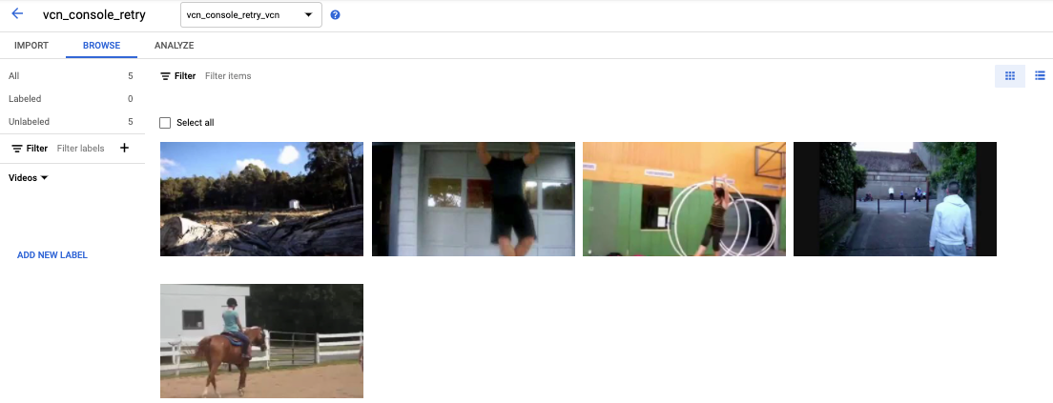
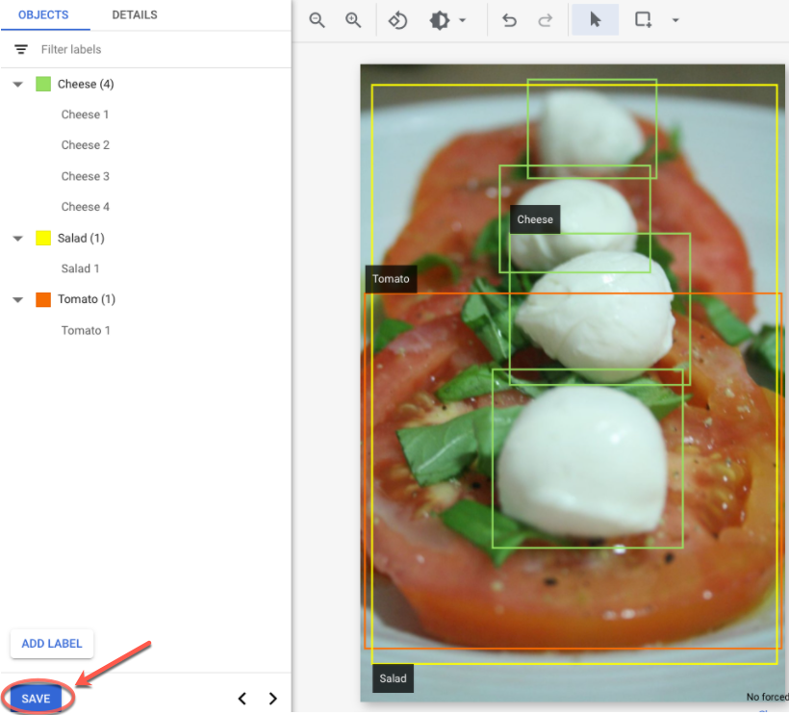
Collect data and Label data using Vertex AI
Collect data by taking many photos of the same object under various permutation like lighting, distortion and etc.
Label the the image by drawing bounding box to tell the machine what is the object in the photo.

Slide 27
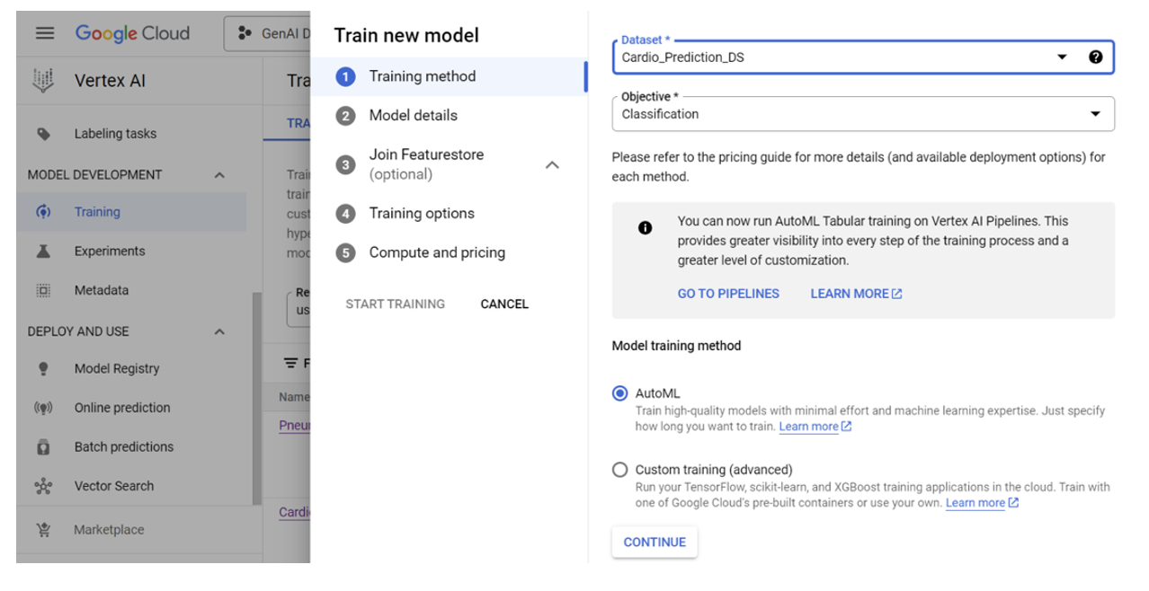
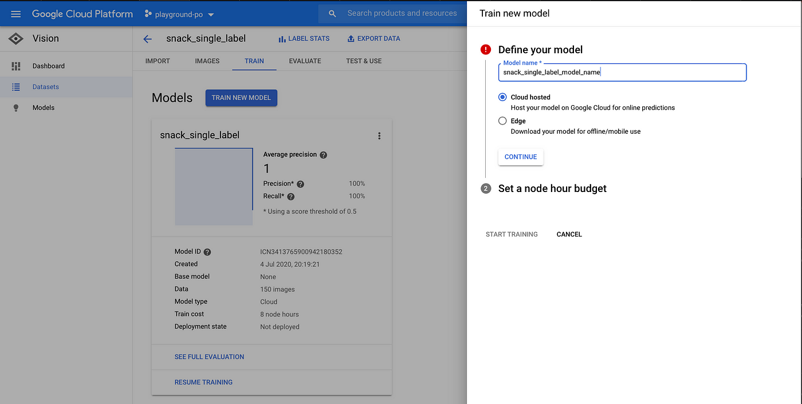
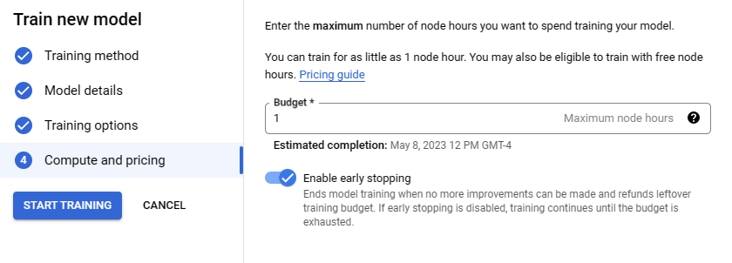
Train a custom model using AutoML Vision in Vertex AI.
Select your dataset that you have labelled.
Select AutoML
Select Edge for inference on laptop.
Set a node hour budget based on your budget and processing timearound time needs. Put 1 is more than enough.

Slide 28
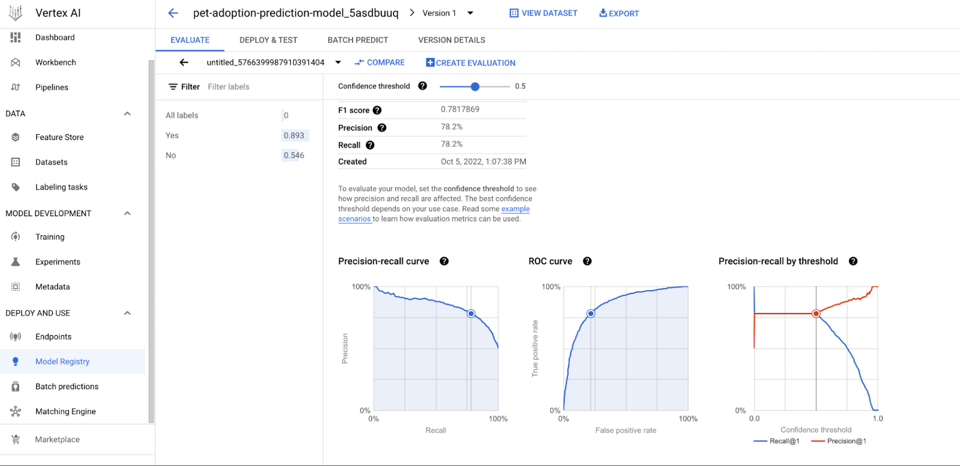
Export model
Exporting the Model:
Once the model is trained, navigate to the Vertex AI Model Registry.
Select the trained model and export it as a TFLite file for use on edge devices.
Download the model and integrate it into an application for real-time inference.
Choosing the Threshold Setting:
After training, Vertex AI provides an evaluation report with metrics like accuracy, precision, recall, and F1-score.
The threshold determines the confidence level required for the model to make a positive classification.
Higher thresholds (e.g., 0.8-0.9): Reduce false positives but may miss some detections.
Lower thresholds (e.g., 0.5-0.6): Detect more objects but increase false positives.
Adjust the threshold based on the Precision-Recall tradeoff to optimize for either sensitivity (more detections) or specificity (fewer false detections).

Slide 29
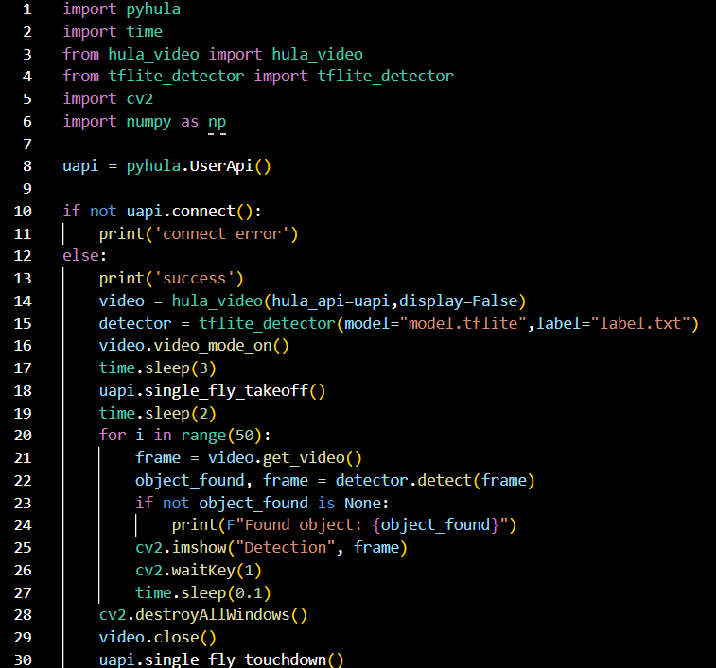
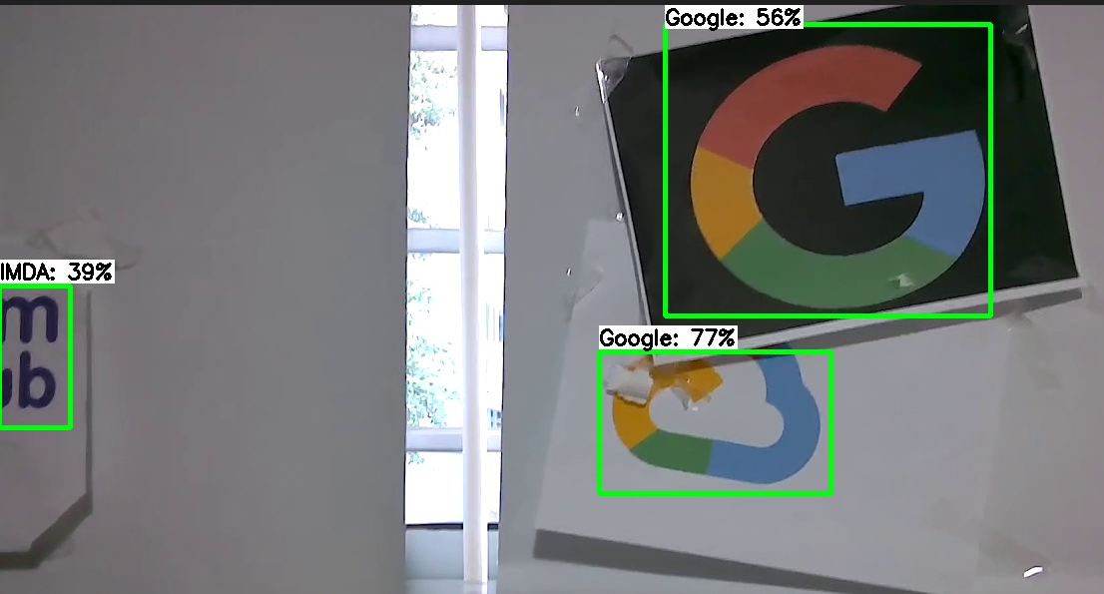
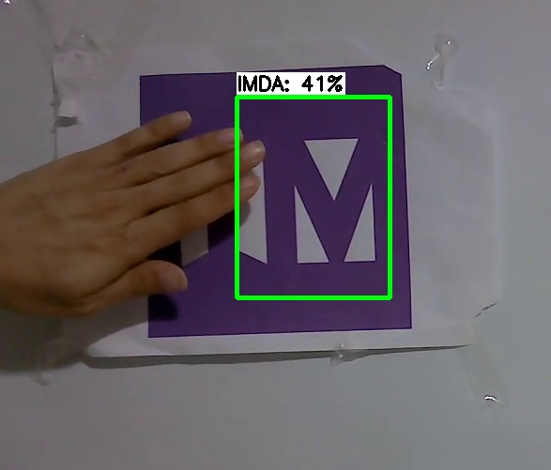
Using the TFLite model to detect Google and IMDA logo with drone camera
Line 4 (VERY IMPORTANT): import tflite_detector library
Line 15: (VERY IMPORTANT)
Initializes an object detection model using TensorFlow Lite.
model="model.tflite": Specifies the path to the TFLite model file.
label="label.txt": Loads the label file, which contains class names corresponding to detected objects.
Line 22:
Uses the detector object detect function to process the frame and detect objects and returns:
object_found: Stores the detected object information in the a dictionary object where:
{'label':object_name,'score': score,'x':x position,'y': y position}
frame: The processed frame (e.g., with bounding boxes drawn around detected objects).

Slide 30
How to use tflite detector
Download tflite_detector.py into the folder that contains your code.
Download a model and label from NYTC 2025 Classwork Model folder
Label contains the name of object that will be detected.
Download tflite_detector api documentation and read to find out the functions that are in that class.

Slide 31
Hands-on Breakout Activities (105 minutes)
Do all questions in Section 4 of Workshop 4 Quiz.

Slide 32
Key Takeaway
Using loops and array
Using video stream from drone camera
Using OpenCV libraries to detect color and circles from video stream
Using TFLite model to detect object

Slide 33
Workshop 4 Practice in School Activity
Write a code that flies the drone two rounds circling around a column that is about 90cm high, 30cm (breadth) x 30cm (width). While circling, the drone’s camera shall face the column.
On the column, there are google and imda logo. The code shall detect the logos as the drone circles around the column.
When reach the top of the column, the drone shall land on the column.
HINT: You have use python threading to run the detection concurrently while the drone flies.

